Slide 1
Python Environment Trouble Shooting

Slide 2
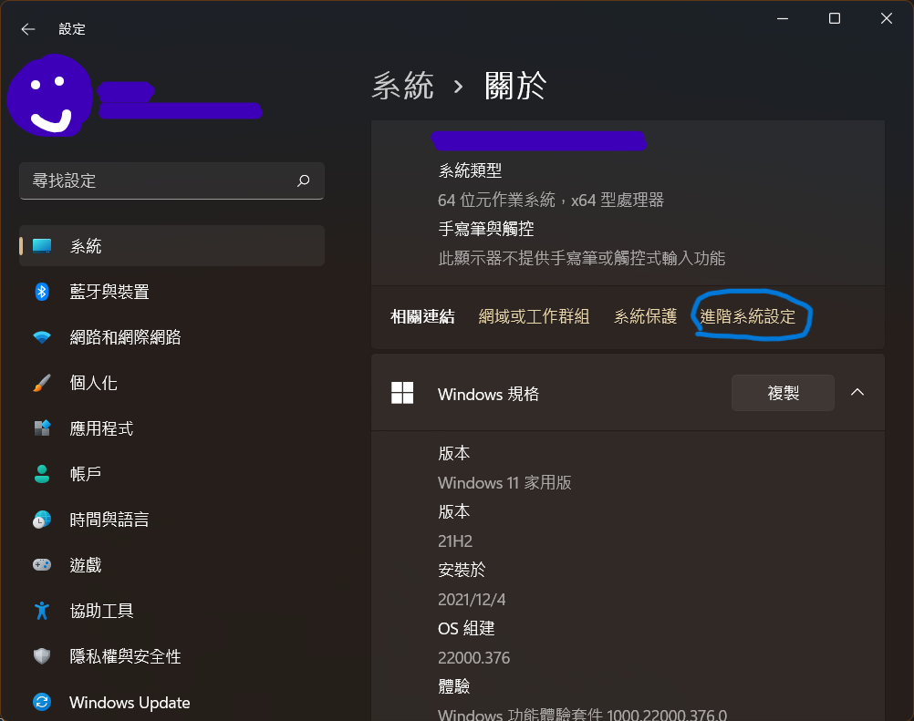
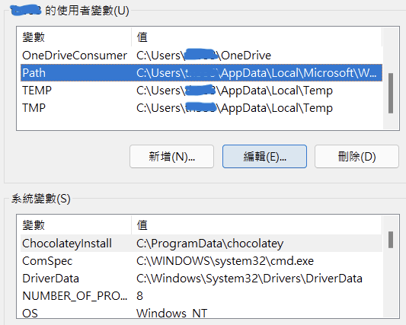
Set Windows PATH
Query path
echo %path% (path with by ;)
echo %path:;=&echo.% (path with carriage return)
Set path
開啟設定 > 系統 > 關於 > 裝置規格 進階系統設定
Windows 預設應用程式位置: %USERPROFILE%\AppData\Local\Microsoft\WindowsApps
重開機生效新的path

Slide 3
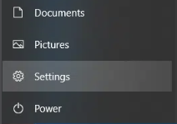
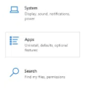

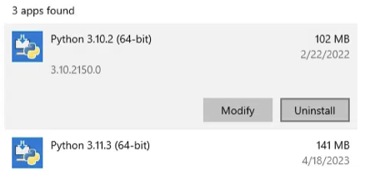
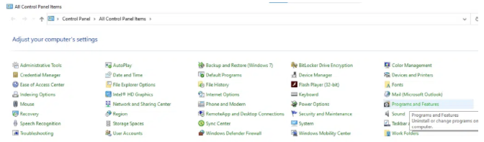


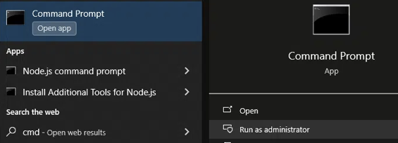
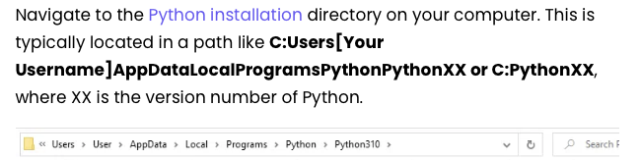
Uninstall Python on Windows
Using Windows Settings
Open “Setting” app from Start menu or by press Win + I
Navigate to “Apps” and then to “Apps & features”.
Serach ‘Python’, Click on Python, slect uninstall
Using the Control Panel
Open “Control Panel” app (search control panel in the Start menu)
Click “Programs” → ”Programs and Features”
Find Python
Right click, then select uninstall
Using the Command Line
Open “Command Prompt” app as an administrator (search ”cmd” in start menu, right-click
Get app list: type wmic product get name
type wmic product where name=”Python x.x.x” call uninstall
Using Python’s Own Uninstaller
In the Python installation folder, look for an executable named uninstall.exe or something similar.
Double-click on this executable to start the uninstallation process.

Slide 4
Uninstall Python on Mac
Terminal basic command
Where python3: all possible Python3
Which python3: will be executed Python3
Print current working directory: pwd
Print environment setting: echo $PATH, echo $HOME
Modify path
Open z-shell setting: open ~/.zshrc (open ~/.bash_profile)
Add line: export PATH="/usr/local/example/bin:$PATH"
Save file
Apply chanages: source ~/.zshrc
Using Terminal
Open terminal, type brew uninstall python
Using Finder
Navigate to /Applications and find the Python folder or Python app
Move it to trash
By remove Python from PATH
Open z-shell file
Remove any lines that add Python files and directories to the PATH variables

Slide 5



Uninstall Arnacoda
MacOS
conda install anaconda-clean
anaconda-clean –yes
rm -rf ~/anaconda3 or sudo rm -rf /anaconda3
Manually delete ~/.anaconda_backup/<timestamp>
In ~/.zshrc or ~/.bash_profile or .bashrc or .profile to remove conda related path setting, like
Remove hidden files or directory i=under HOME, .condarc, .conda, .continuum
Move Conda APP to trash
Windows
In the folder where you installed Anaconda (Example: C:\Users\username\Anaconda3) there should be an executable called Uninstall-Anaconda.exe. Double click on this file to start uninstall Anaconda.

Slide 6
Jupyter Lab Trouble Shooting
Check if browser is outdated
Uninstall jupyter lab: pip3 uninstall jupyterlab
Install jupyter lab

Slide 7
Python Related Files Location
Python 3.12.1 (system) for IDLE, Jupyter Lab (standalone) and Python shell (RPEL: via Terminal type python3)
/Library/Frameworks/Python.framework/Versions/3.12/bin/Python3
/Library/Frameworks/Python.framework/Versions/3.12/lib/python3.12/site-packages/pandas
Python 3.10.11 Thonny 自帶
執行檔： /Users/jacky/Applications/Thonny.app/Contents/Frameworks/Python.framework/Versions/3.10/bin/python3.10
資源檔：使用者安裝 /Users/Jacky/Library/Python/3.10/lib/python/site-packages
資源檔：Thonny預裝 /Users/jacky/Applications/Thonny.app/Contents/Frameworks/Python.framework/Versions/3.10/lib/python3.10/site-packages
IPython是一種基於Python的互動式直譯器。相較於原生的Python Shell，IPython提供了更為強大的編輯和互動功能。基本上跟Jupyter綁一起
where python
/Library/Frameworks/Python.framework/Versions/3.12/bin/python3
/usr/local/bin/python3
/usr/bin/python3
幾個有用的函數
(A) python3 -m site
(B) >>>import sys
>>> sys.executable
>>> sys.path
>>> sys.prefix
(C) >>>import numpy
>>>numpy.__file__

